Slide 1
Conjunctival Tumors
Helen K. Wu, MD
New England Eye Center
Tufts University School of Medicine
Boston, MA

Slide 2
Acknowledgements
Co-Authors
Michelle Ying, MD
Maayan Keshet, MD
Prithi Batta, MD
Dan Hu, MD
None of the authors have financial interest in the subject matter

Slide 3
Case Presentation
80 year old man presents s/p removal of conjunctival lesion
Otherwise healthy

Slide 4
Avascular Corneal Membrane

Slide 5
Case Presentation
Biopsy of conjunctiva and cornea reveals carcinoma in situ
A small greyish membrane nest persists in superotemporal cornea
Patient is treated for four months with alpha-2-interferon drops (1 million units/ml) with resolution of membrane
Continued drops for total of 9 months and is clinically free of tumor

Slide 7
Case Presentation
47 year old man with AIDS and progressive multifocal leukoencephalopathy was referred from psychiatric hospital with a 2 day history of red eye and pain OS
No significant past ocular history

Slide 8
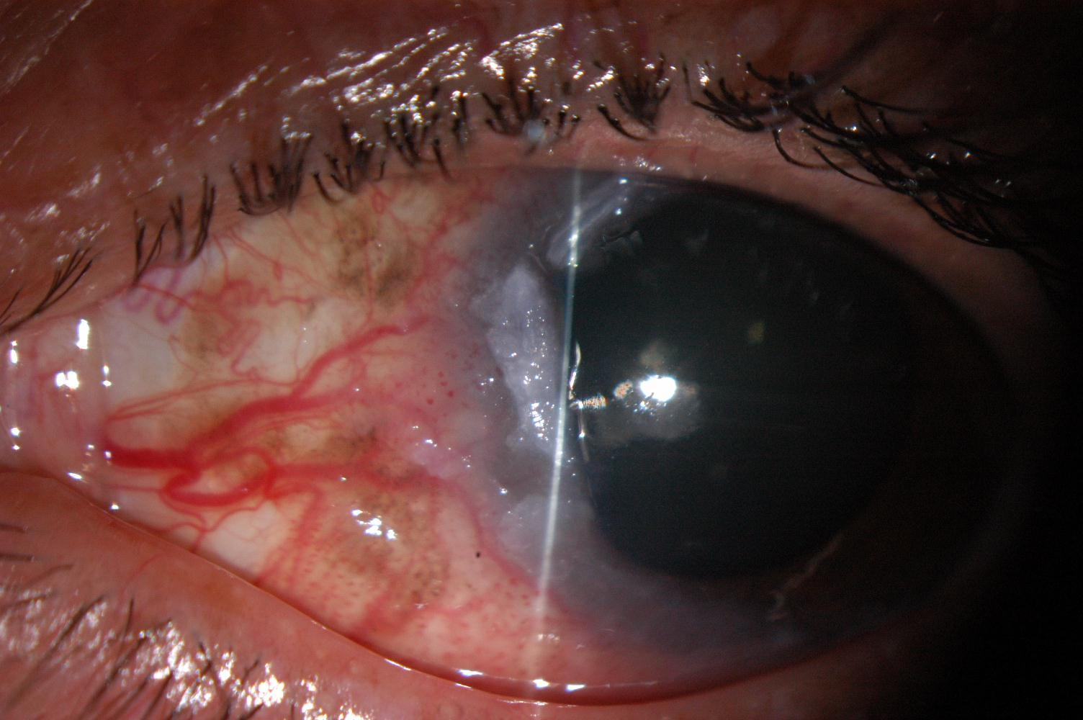
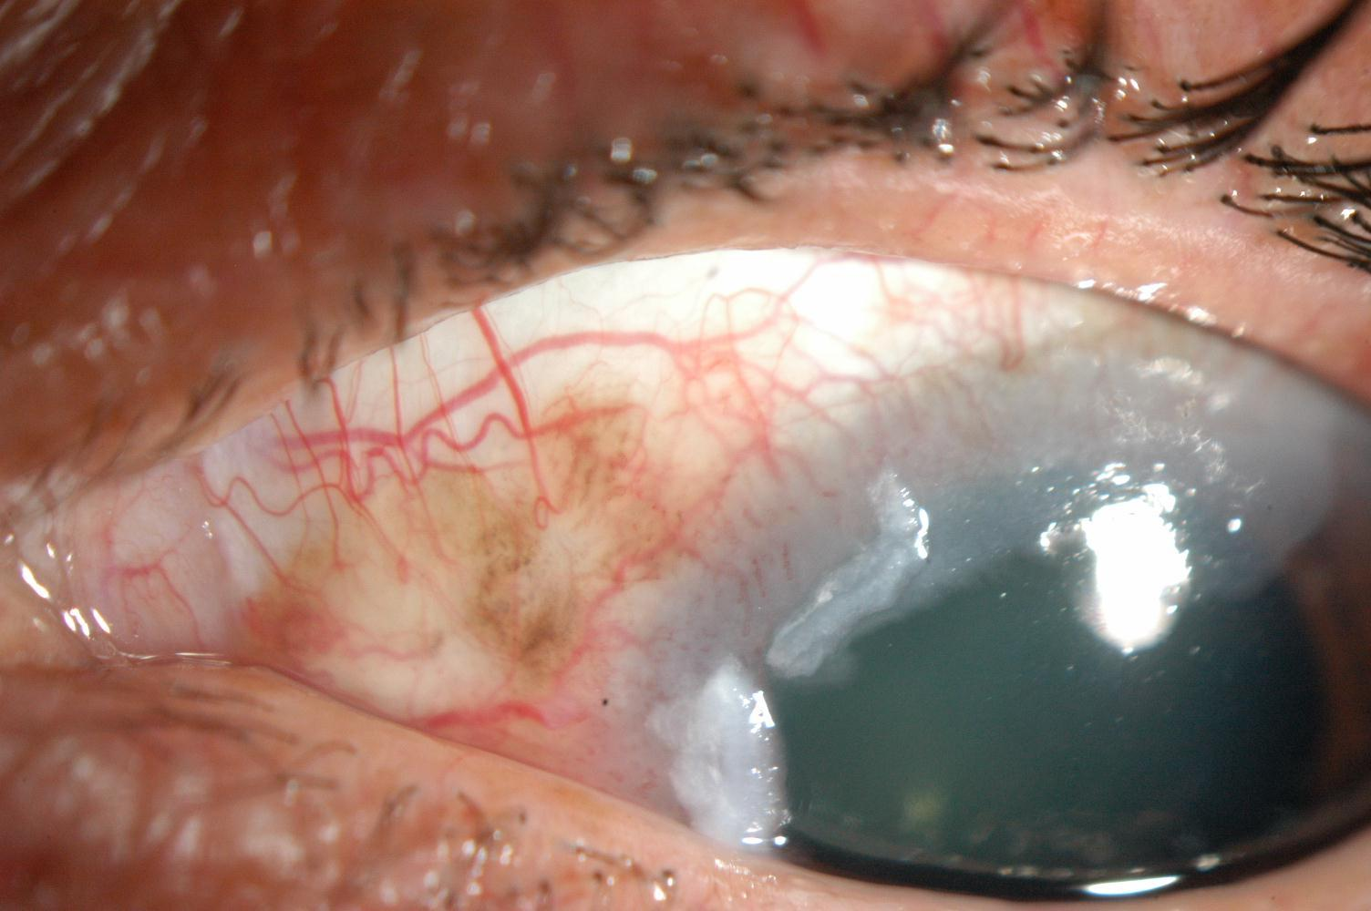
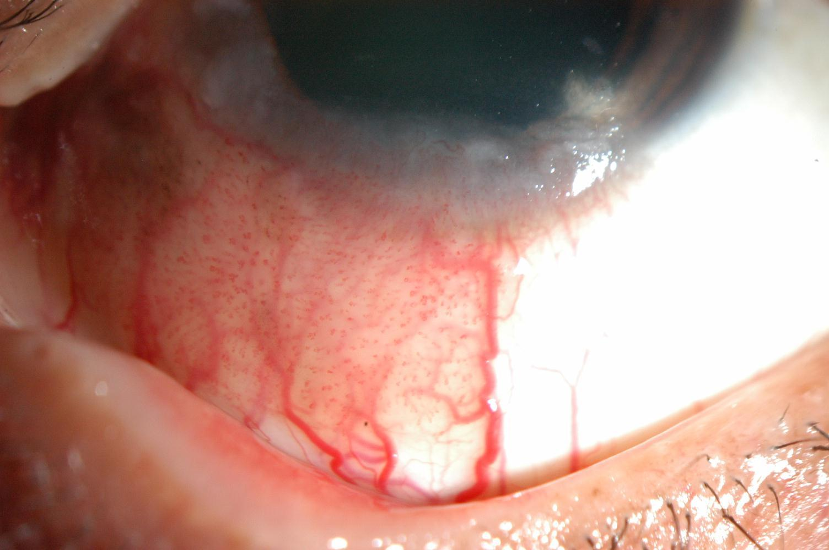
Examination
9 clock hours of papillomatous lesion with extension onto cornea and areas of pigmentation
Notes:
Papillomatous lesion on bulbar conjunctiva from approximately 5 o’clock to 2 o’clock around limbus (total at least 9 clock-hours); gelatinous limbal and peripheral corneal lesions with frosted glass extensions on cornea; dilated feeder vessels (mulberry); prominent areas of melanosis within lesion

Slide 9
Differential Diagnosis
Benign
Squamous Papilloma
Keratoacanthoma
Hereditary Benign Intraepithelial Dyskeratosis
Keratotic Plaque
Actinic Keratosis
Pterygium
Pingueculum
Malignant
Conjunctival Intraepithelial Neoplasia (CIN)
Invasive Squamous Cell Carcinoma
Variants:
Mucoepidermoid
Spindle cell
Pigmented
Sebaceous Cell Carcinoma
Conjunctival Melanoma
Notes:
Sebaceous cell – rare
Melanoma – also rare; but consider for lesions containing pigment, such as this patient – will discuss later in presentation

Slide 10
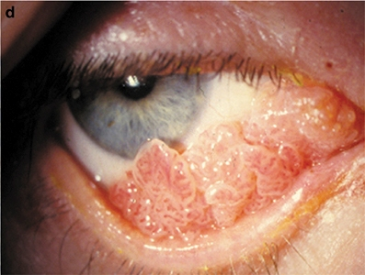
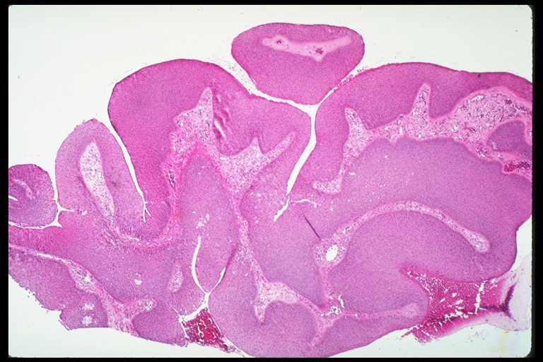
Benign Lesions
Squamous Papilloma:
Most common benign neoplasm of conjunctiva
Associated with HPV
Pink, fibrovascular frond of tissue, either sessile or pedunculated
On pathology, finger-like projections of fibrovascular tissue, usually acanthotic, with hyperkeratosis
Treat with surgical excision, cryotherapy, +/- topical chemotherapy

Slide 11
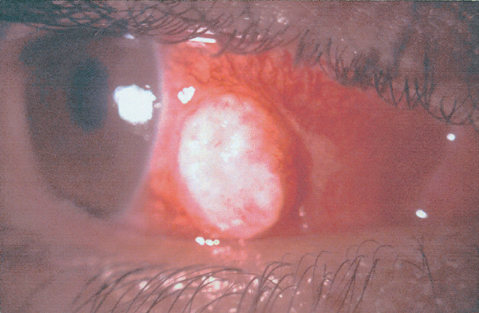
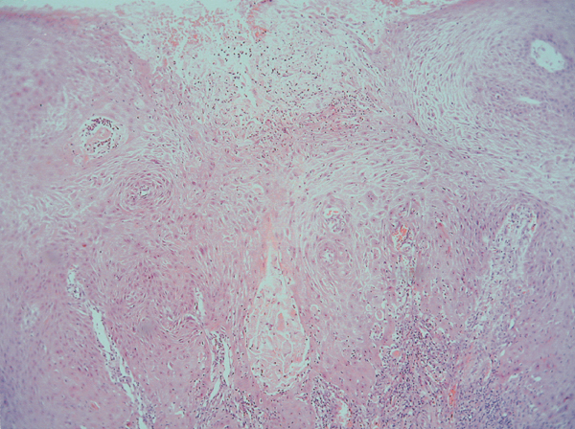
Benign Lesions
Keratoacanthoma:
Inflammatory lesion that may mimic carcinoma
Raised, fleshy, often nodular lesion; sometimes gelatinous or leukoplakic
Rapid onset
On pathology, hyperkeratosis and acanthosis with neutrophilic infiltrate and microabscesses
Treat with excision

Slide 12
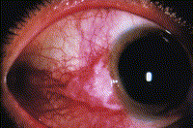
Benign Lesions
Keratotic Plaque:
White conjunctival mass with keratinized, acanthotic epithelium; appears similar to squamous cell carcinoma with leukoplakia
Hereditary Benign Intraepithelial Dyskeratosis:
Seen primarily in select Native Americans; autosomal dominant disorder with elevated fleshy plaques; shows acanthosis, dyskeratosis, and inflammatory cells
Actinic Keratosis:
Frothy white lesion often located over a pingueculum or pterygium; shows dysplastic, keratotic epithelium; also resembles squamous cell carcinoma

Slide 13
Malignant Lesions
Squamous cell carcinoma-pre-invasive
Conjunctival intraepithelial neoplasia (CIN)
Mild or severe dysplasia, depending on thickness of abnormal cell proliferation
Carcinoma in situ (CIS)
Full thickness replacement of epithelium with abnormal cells
Invasive squamous cell carcinoma
Invades stroma, may metastasize

Slide 14
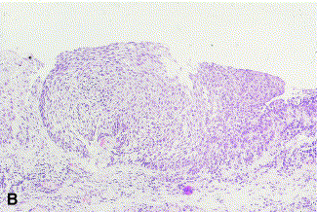
Pathology
Conjunctival Intraepithelial Neoplasia
Notes:
CIN: abrupt transition zone between normal epithelium and thickened atypical epithelium; all within epithelium, no stromal involvement; see dysplastic cells

Slide 15
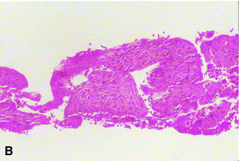
Pathology
Corneal Intraepithelial Neoplasia
Notes:
Abrupt transition between normal corneal epithelium and thickened anaplastic epithelium

Slide 16
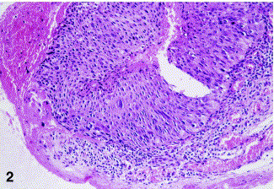
Pathology
Carcinoma-in-situ
Notes:
Markedly thickened epithelium with atypia and loss of cellular polarity, involving the full thickness of the epithelium, but no invasion of the basement membrane

Slide 17
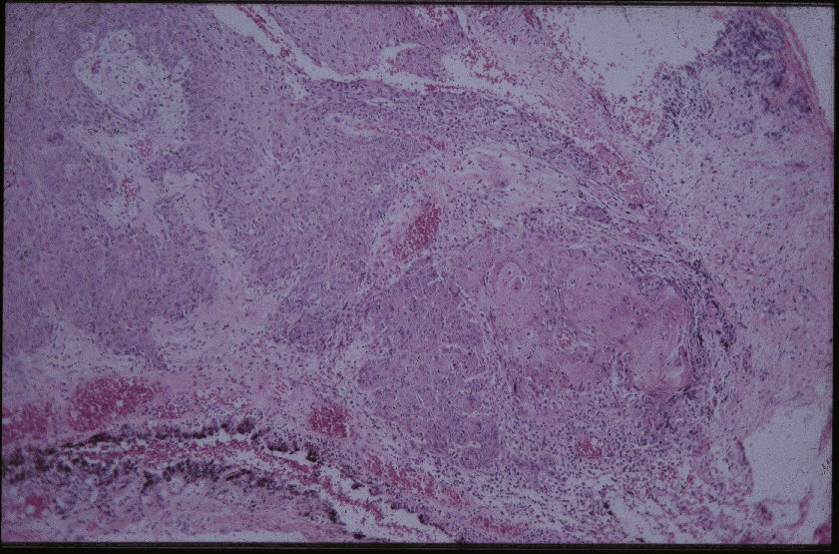
Pathology
Squamous Cell Carcinoma
Notes:
Islands of anaplastic cells with involvement of margins – difficult to distinguish locations of stroma, BM, epithelium because all are invaded by tumor – boundaries lost; see poorly differentiated cells, loss of polarity (growth in all directions rather than neat layers)

Slide 18
Conjunctival CIN
Most common conjunctival malignancy in U.S.
Usually seen in older males
Typically found in intrapalpebral fissure or at limbus
Associated with UV light exposure, fair pigmentation, HPV infection, and HIV (younger pts)
Precursor to squamous cell carcinoma
Partial involvement of epithelium without invasion of basement membrane

Slide 19
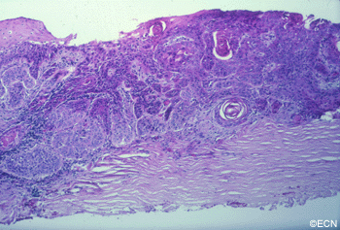
Conjunctival CIN
Diagnosis with conjunctival biopsy
Treatment involves wide excision with adjunctive cryotherapy
Recurrence rate after excision 5 to 50% (correlated with involvement of excised margins)
MMC and interferon α 2b drops (or injection) may be used in conjunction with surgery
Intraocular or orbital invasion rare

Slide 20
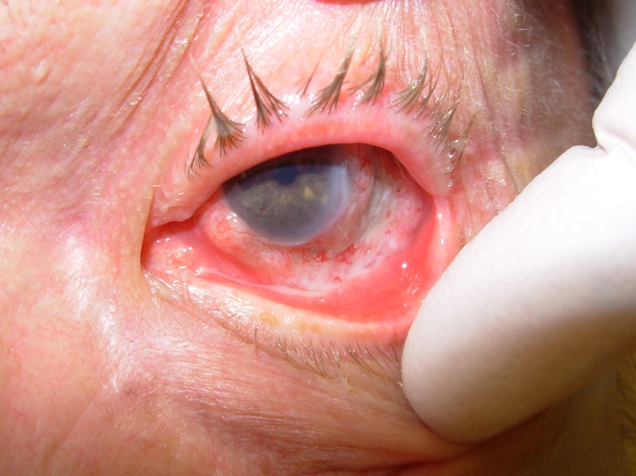
Risk Factors for Squamous Cell Neoplasias
Age
Male sex
Sunlight exposure
Smoking
Light complexion
HIV or AIDS
HPV
Image from emedicine.com 2008

Slide 21
Clinical Feature of Squamous Neoplasias
Located in interpalpebral zone
Large size, prominent vessels, spontaneous hemorrhage, and strong adhesion to globe posterior to limbus suggestive of malignancy
Five types: papilliform, gelatinous, nodular, leukoplakic, or diffuse
Up to 50% with corneal involvement; scleral involvement in 20-40%
Metastasis rarely seen but more common in AIDS patients

Slide 22
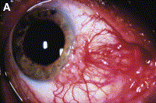
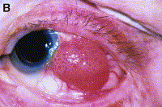
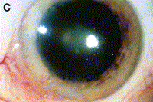
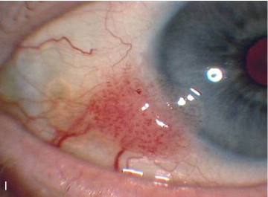
Types
Gelatinous
Leukoplakic
Nodular
Diffuse
Papilliform
Notes:
A: gelatinous 2: leukoplakic B: nodular C: diffuse I: papilloform

Slide 23
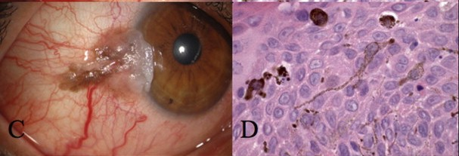
Pigmented Squamous Cell CA
Can mimic conjunctival melanoma
Risk of metastasis from SCC less than 1% in 10 years; risk from melanoma 26%
Shields, C.L. et al. Pigmented Squamous Cell Carcinoma In Situ of the Conjunctiva in 5 Cases. Ophthalmology 2008; 115: 1673-8.
Out of 305 eyes with conjunctival SCC, only 5 with pigmented SCC (1.6%)
Clinically, pts had strong intrinsic brown pigment in SCC lesion; on pathology, all showed dendritic melanocytes interspersed among tumor cells
Notes:
In general, squamous cell carcinoma is non-pigmented; rare to have pigmented SCC. However worth discussing given presence of pigmented areas in this pt’s lesion; SCC with prominent pigmentation can be mistaken for melanoma; important to distinguish given that melanoma is more aggressive with much higher metastasis rate – therefore treatment and follow-up may be different
Pigmented SCC, as discussed in Shields article, usually have strong brown pigment intrinsic to lesion – more prominent than the pigment in our patient

Slide 24
Treatment
Surgical excision with cryotherapy (recurrence rate 10-20%)
No touch technique
Partial lamellar sclerectomy and keratectomy
Absolute alcohol to scleral bed
Topical chemotherapy-better results on smaller thinner tumors; may be used as adjuntive therapy to shrink prior to excision
5-fluorouracil
Mitomycin-C-most published data
Interferon alpha-2b-less toxic but longer treatment
Radiation

Slide 25
Side Effects of Surgical Excision
Difficult to obtain clear margins-surgical excision may leave subclinical microscopic tumor cells so relatively high recurrence rate
Extensive scarring may result after wide excision with potential diplopia, symblepharon formation, dryness
Limbal stem cells may be damaged with conjunctivalization of cornea
May develop intraocular inflammation, corneal edema or fibrosis, and iris atrophy from cryotx

Slide 26
Topical Chemotherapy
MMC may cause stromal necrosis, corneal toxicity and ulceration, punctal stenosis, uveitis, and cutaneous erythema and edema
Alpha-interferon is less toxic but may require prolonged therapy and is expensive
Alpha-interferon may be given as injections subconjunctivally

Slide 27
Radiation
Limited role in management of squamous neoplasms
When used, high-dose plaque radiotherapy is required, as squamous cell carcinoma relatively radiation resistant
Plaque must cover entire span of tumor, making it difficult to use for diffuse tumors; more useful for tumors with multiple recurrences
Side effects: scleral necrosis, cataract formation

Slide 28
Follow Up
Surgical excision with adjunctive cryotherapy (10 clock hours involvement with 20 mm extension) was performed with amniotic membrane reconstruction
Pathology showed CIN with positive margins
Recurrence at limbus noted at one month
Undergoing topical MMC therapy

Slide 29
Pathology

Slide 30
Pathology

Slide 31
Follow-up Photos

Slide 32
Case Presentation
72 year old Caucasian man referred for redness and growth on right eye for several months, which has gotten bigger
Past history notable for prostate cancer, s/p resection (no radiation) and SCCA of scalp
BCVA of 20/20 OU
Exam WNL except for right eye papillomatous growth with corneal extension

Slide 33
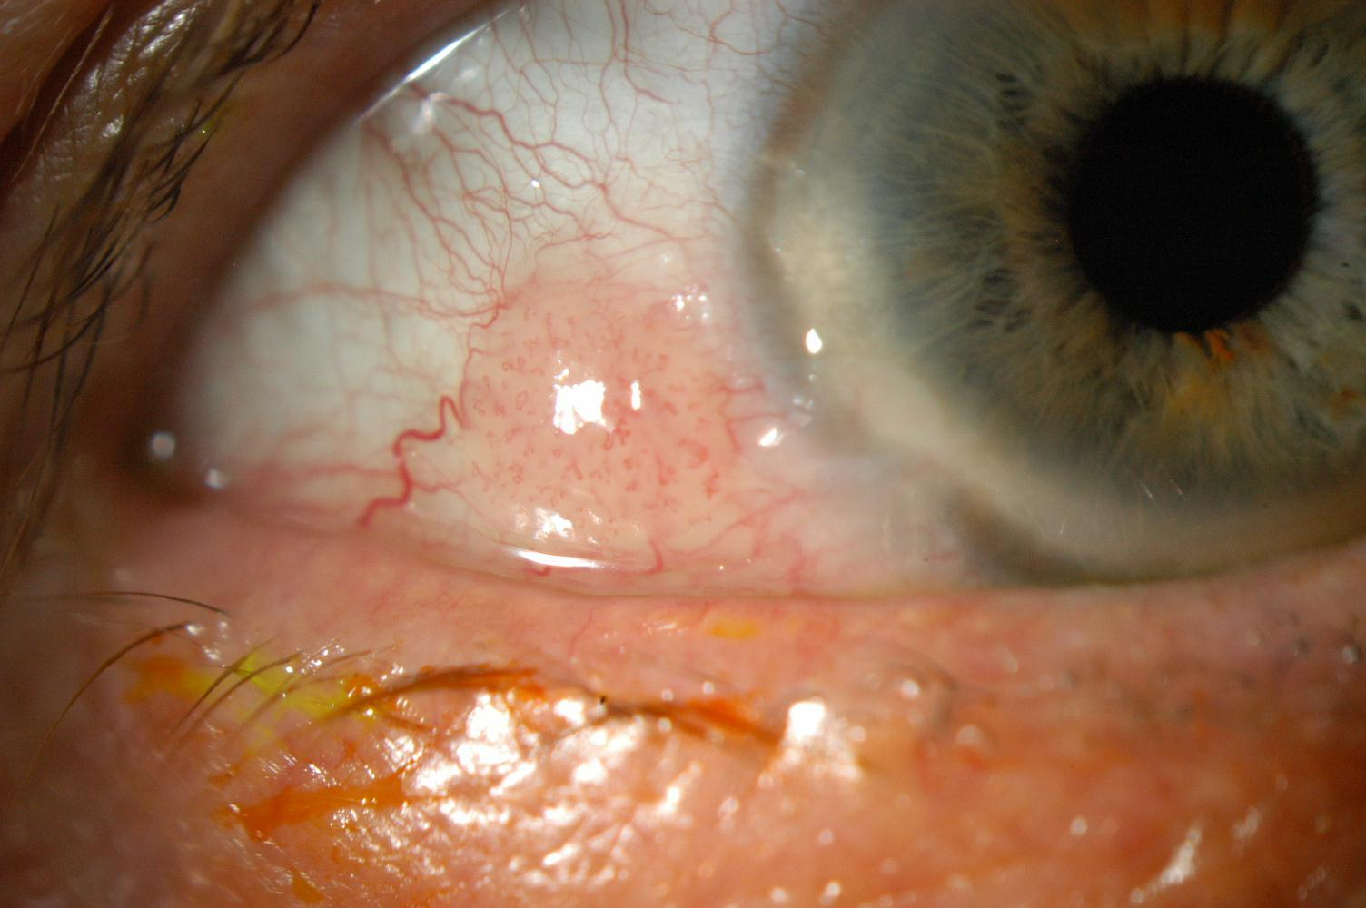
Examination

Slide 34
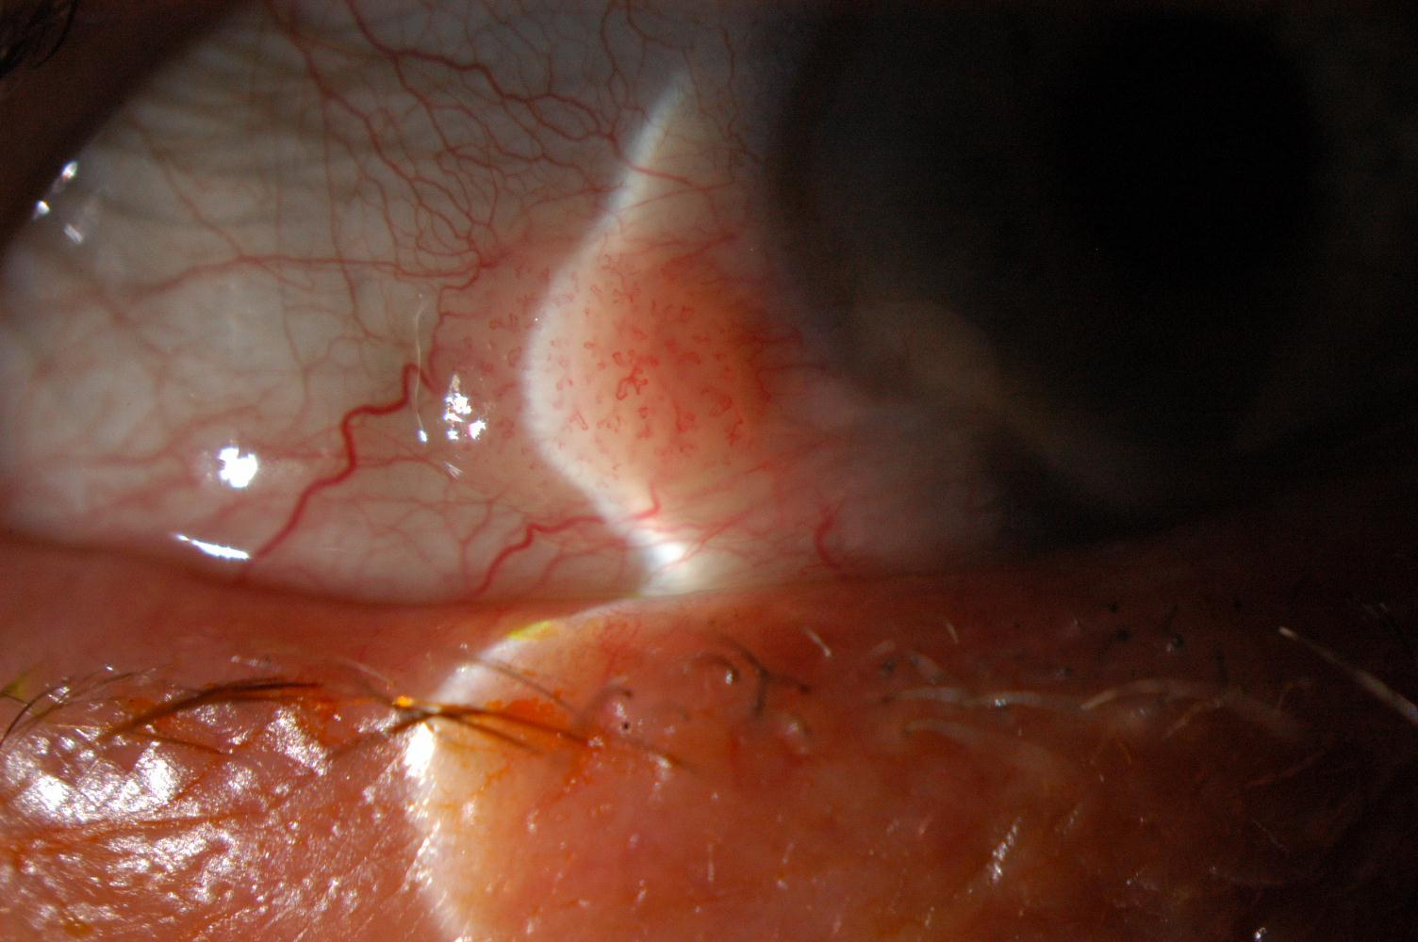
Examination

Slide 35
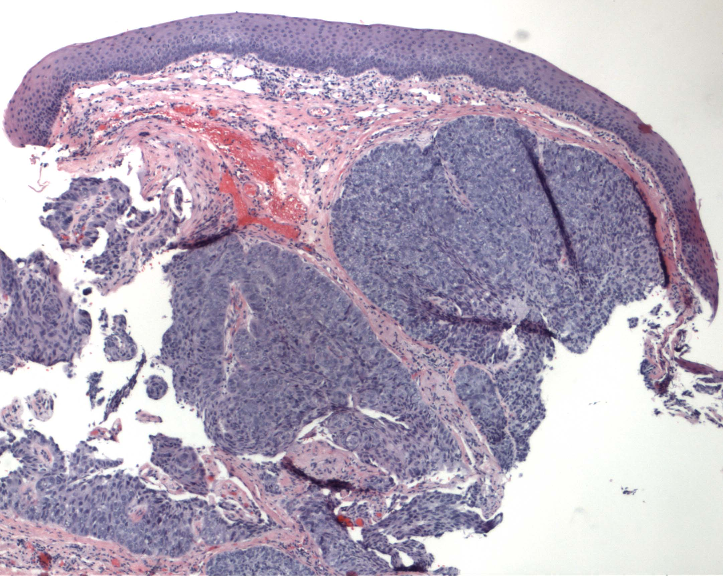
Pathology
Notes:
Low power view – large neoplastic cells in middle of epithelium; usually other carcinomas have large cells from bottom up

Slide 36
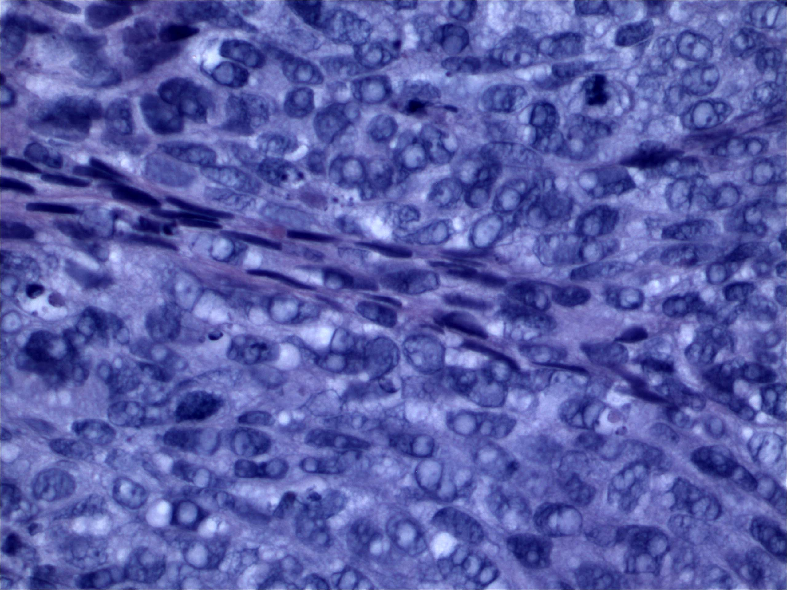
Pathology
Note foamy vacuolated cytoplasm of malignant cells
Notes:
Higher power view of malignant cells; foamy vacuolated cytoplasm

Slide 37
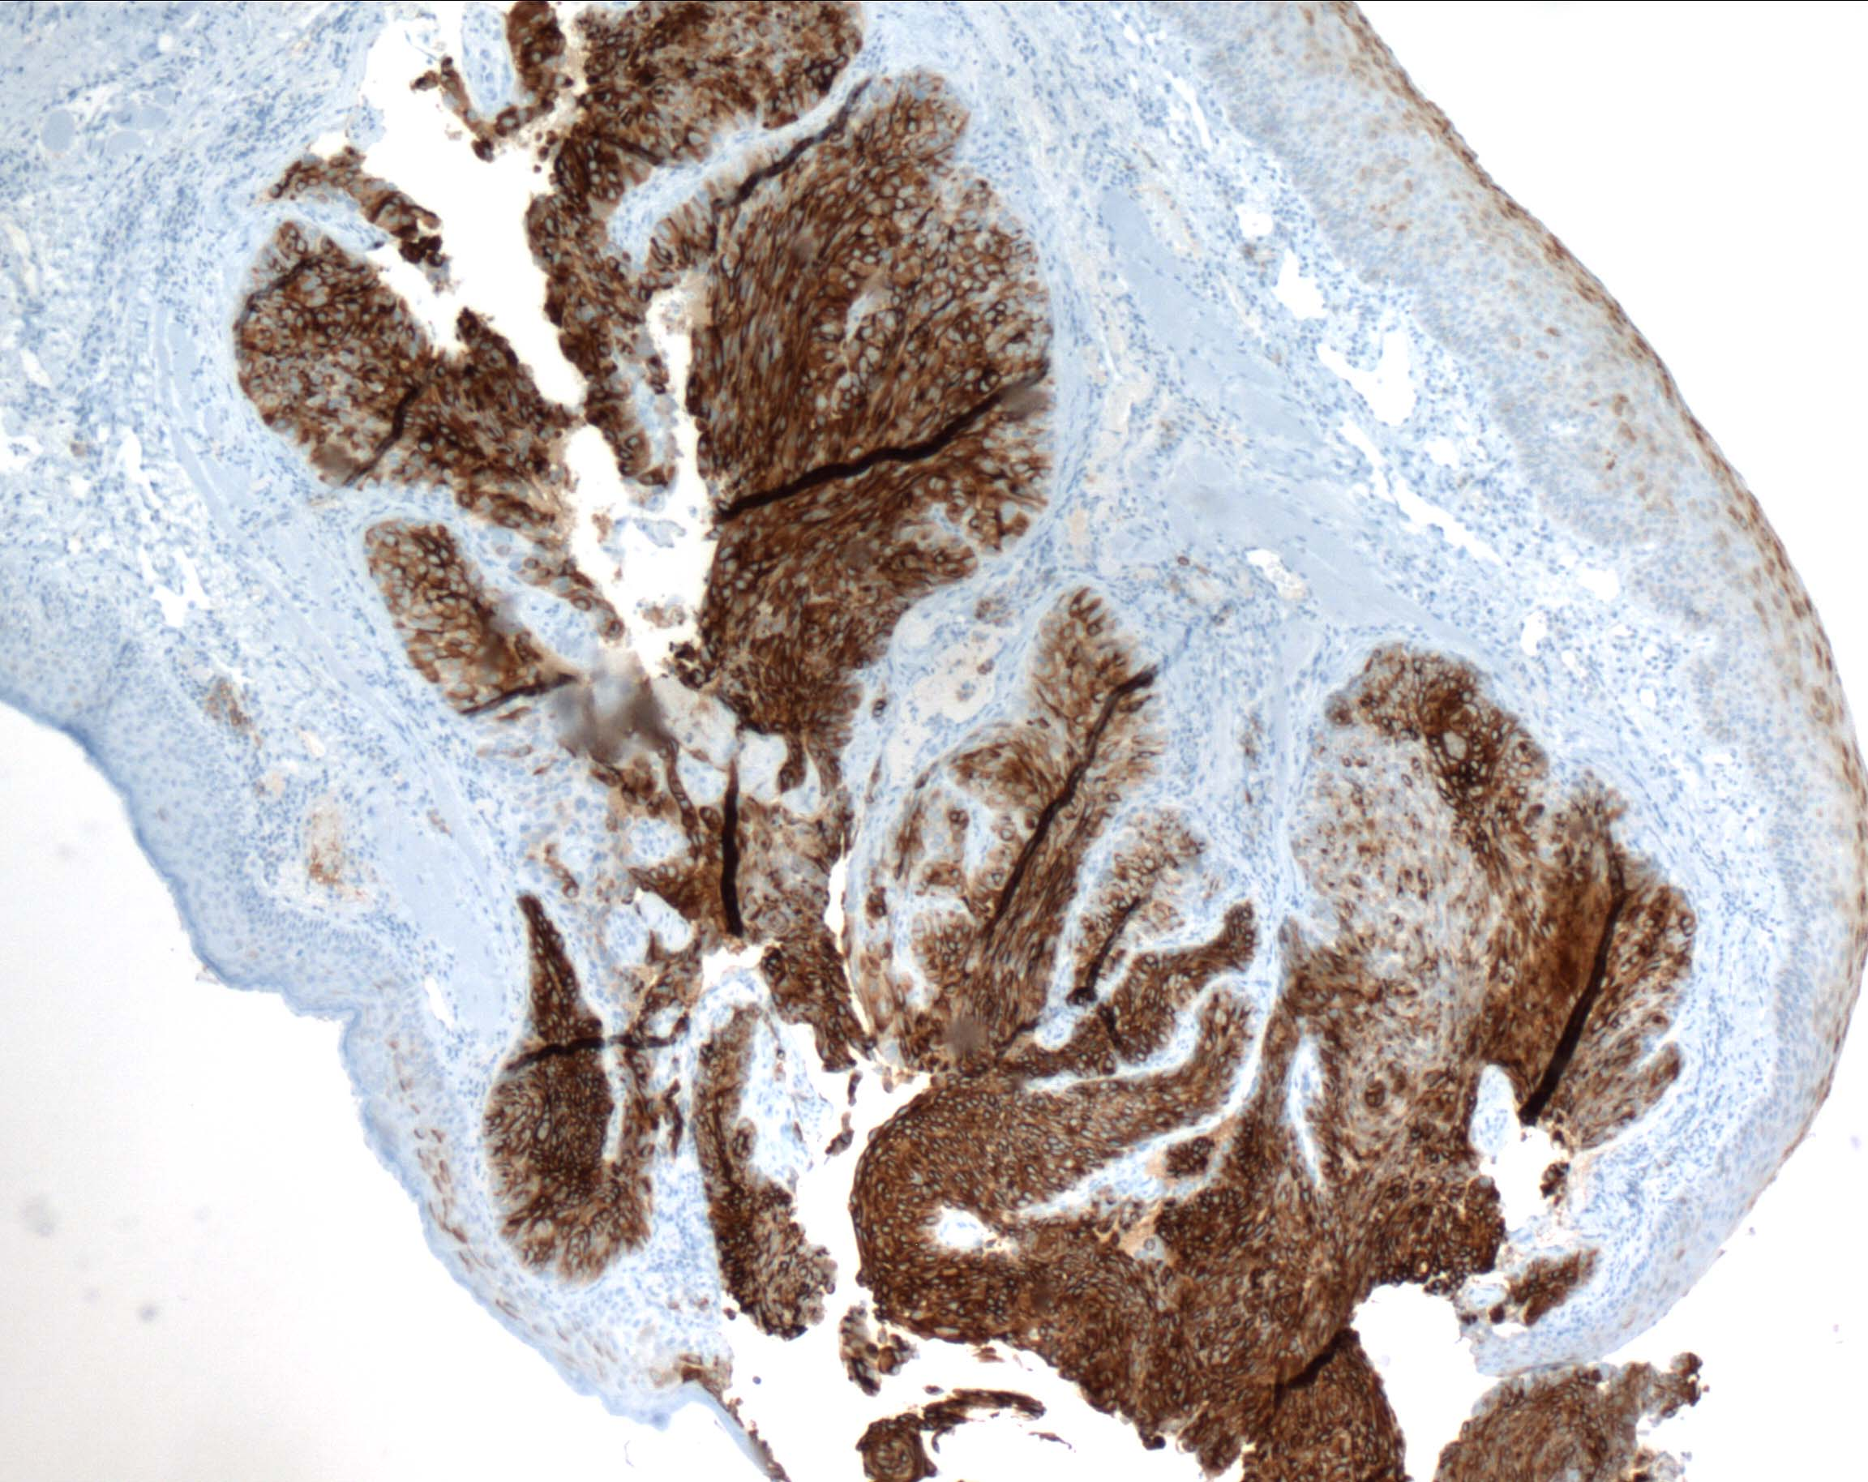
Pathology
Focal positive immunohistochemical staining for epithelial membrane antigen (EMA)
Notes:
Immunohistochemical staining reveals focally positive for epithelial membrane antigen (EMA) secreted by sebaceous carcinoma cells.

Slide 38
Pathology
Intraepithelial neoplasm, most consistent with sebaceous carcinoma with pagetoid involvement of conjunctiva
Positive margins

Slide 39
Sebaceous Cell Carcinoma
Most common in periocular area in the meibomian and Zeis glands
Mortality rate is 22%
Most common in women in 70s
More common in Caucasians in U.S. but higher incidence in Asians and Indians
Most common on upper lid
May be seen in younger patients with a history of radiation to face

Slide 40
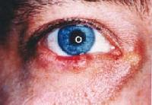
Sebaceous Cell Carcinoma- Variable Clinical Presentation
May masquerade as chronic blepharitis or chalazion
Firm painless mass
May mimic unilateral blepharoconjunctivitis, basal or squamous cell CA, conj or corneal CIN, SLK, orbital inflammation
May have loss of eyelashes
Glassman, et al
eMedicine, 2006

Slide 41
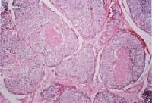
Sebaceous Cell Carcinoma-Pathologic Features
Glassman, et al
eMedicine, 2006
Characterized by pagetoid spread (intraepithelial spread like Paget’s disease)
May be multicentric with numerous sebaceous elements and mitotic figures, nests with central necrosis
Foamy cytoplasm seen; positive fat stains
Aggressive local control and sentinel node biopsy (tumor invades locally)
Some favor exenteration if diffuse

Slide 42
Case Presentation
82 year old white female who complained of burning and dryness for six years, along with crusting and discharge
She had tried topical cyclosporine twice (one month each time) and had also been tried on erythromycin ointment for blepharitis

Slide 43
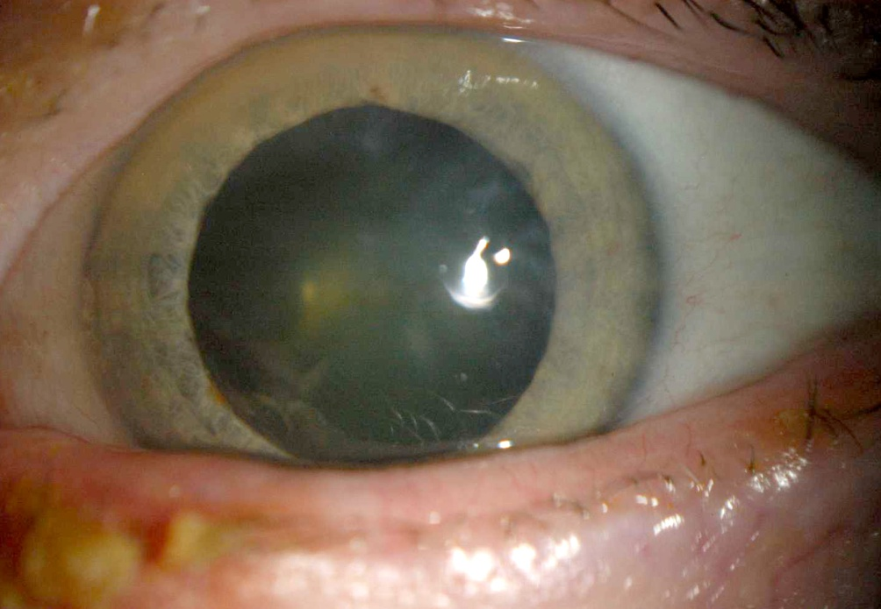
July 2007

Slide 44
Severe Crusting on LLL margin

Slide 45
Case Presentation
Returned to cornea clinic four months after initial presentation and subsequent referral to oculoplastic service
Diagnosed with sebaceous cell CA and underwent MOHS resection and reconstruction of LLL
She was noted to have irregular area of limbal conjunctiva with a vascular membrane extending onto the cornea

Slide 46
November 2007

Slide 47
November 2007

Slide 48
Conjunctival Biopsy
Sebaceous cell CA of conjunctiva found in inferonasal conjunctiva
A repeat biopsy was performed adjacent to the initial one, and 10 additional map biopsies were performed, including the bulbar and palpebral conjunctiva
Superonasal and medial biopsies positive for sebaceous cell CA
4 cycles of MMC given

Slide 49
12/27/07

Slide 50
12/27/07

Slide 51
Case Presentation
She subsequently underwent cataract surgery OS with postoperative corneal ulceration complicating postoperative course
Rheumatoid arthritis and prior treatment with MMC were likely contributors to corneal melting
Patient is currently on oral prednisone to halt inflammatory process

Slide 52
Sebaceous Carcinoma
Relatively rare malignant tumor that usually arises from meibomian glands, Zeis glands, or sebaceous glands
Usually in eyelid (1-5% of all eyelid malignant neoplasms)
Also can occur in extraorbital sites: parotid gland, submandibular gland, chest, extremities, and anterior neck region
Notes:
Abundance of Sebaceous glands in ocular region: Meiboman, Zeis, caruncle or eyebrow

Slide 53
Demographics and Risk Factors
Disease of older individuals; (mean pt age ranged from 57 – 72 years)
More common in women
More common in whites in North America; Higher incidence in Asians and Indians
Prior irradiation and immunosuppression are risk factors
Association with Muir-Torre Syndrome
Notes:
Muir-Torre Syndrome = autosomal dominant; a syndrome that combines at least one sebaceous neoplasm (sebaceous adenoma, sebaceous epithelioma, or sebaceous carcinoma) and at least one visceral malignancy (usually gastrointestinal or genitourinary carcinomas). Association with diuretics

Slide 54
Sebaceous Carcinoma
Most sebaceous carcinomas arise from meibomian glands within the tarsus
One study found 63% upper eyelid, 27% lower eyelid, and 5% both eyelids
Typically secondarily invades the conjunctival epithelium by a centripetal migration of tumor cells
Reported cases in which sebaceous carcinoma is confined to conjunctival epithelium or epidermis, with no demonstrable deeper involvement of tarsus or dermis
Notes:
40-80% of cases displays intraepithelial conj invasion (pagetoid invasion)
Earlier reports stated that pagetoid invasion was correlated with poor ocular and life prognosis.

Slide 55
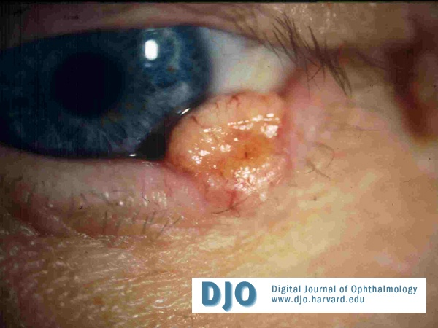
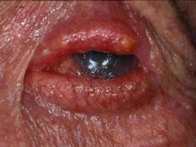
Sebaceous Carcinoma
Most common clinical presentation is a painless, firm, sessile to round, subcutaneous nodule in the eyelid.
Second most frequent presentation is a diffuse unilateral thickening of the eyelid.
“Masquerade syndrome” - can masquerade as a chalazion, blepharitis, blepharconjunctivitis, superior limbic keratoconjunctivitis, and anterior orbital mass
Can directly extend into the orbit, lacrimal system, and the brain. Metastasis via preauricular, parotid, and cervical lymph nodes.
Notes:
Distant metastasis occasionally probably by hematogenous routes: lung, liver, bone, and brain

Slide 56
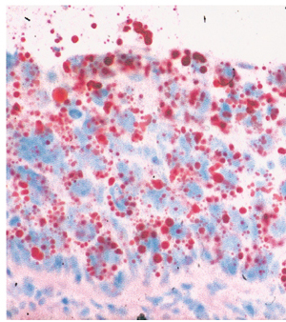
Pathology and Pathogenesis
Characterized by replacement of the normal lobules of the sebaceous glands by large anaplastic cells with foamy cytoplasm
Four histopathologic patterns: lobular, comedocarcinoma, papillary, and mixed.
Collect a frozen section and apply oil red-O stain
Immunohistochemistry (EMA, Cam 5.2, BRST-1) can be helpful to differentiate from basal and squamous cell carcinoma.
Ability to exhibit intraepithelial spread into eyelid epidermis and conjunctival epithelium (pagetoid spread)
Appear to arise de novo
May be a relationship with HPV
Notes:
Lobular pattern most frequent; Comedocarcinoma lobules show necrotic central core surrounded by peripheral viable cells.
Sebaceous carcinoma express EMA, Cam 5.2, and BRST-1 marker which is determined by immunohistochemistry.
Pagetoid spread reported to occur form 44-80% of cases;
Not from a pre-existing sebaceous adenoma, sebaceous hyperplasia, or sebaceous nevus

Slide 57
Management
Primary excisional biopsy/excision with cryotherapy
Incisional biopsy (establish diagnosis for more advanced primary lesions)-full thickness eyelid
Frozen Sections or Mohs
Map Biopsies with cryotherapy
Eyelid and Conjunctival Reconstruction
Topical Chemotherapy
Orbital Exenteration
Notes:
Incisional biopsy – full-thickness piece of eyelid; Complete surgical removal when possible; Preferable to remove lesions in one initial step; 5 mm margins; Mohs microsurgery has been used successfully at time of primary excision especially of lid lesions. Since tendency for diffuse involvement in eyelid and conjunctiva, map biopsies are important to help determine extent of disease and to plan definitive treatment. Ill-defined nature of pagetoid invasion makes treatment of SC challenging. Graft with amniotic membrane combined with cryotherapy. Shields advocate cryotherapy for map biopsy and surgical excision. Topical chemo (MMC) useful for pagetoid invasion of conj; In general irradiation is not highly effective; but may be an alternative to exenteration in older patients; Orbital exenteration – performed less often today; it is probably most appropriate option for cases of unresectable orbital extension and no evidence of distant metastasis. Fine-needle aspiration biopsy for regional lymph node metastasis; Chemo for distant metastasis

Slide 58
Prognosis
Varies with extent of disease and the type of treatment employed
Worse prognosis = vascular, lymphatic, and orbital invasion; both eyelids involved; poor differentiation; multicentric origin; duration of symptoms > 6 months; tumor diameter > 10 mm; highly infiltrative pattern and pagetoid invasion
Reported local recurrence rates range from 9 - 36%.
Local recurrence tends to occur within 5 years
Metastasis occurs in 14 - 25%.
Periocular mortality 9 - 15%
5 year mortality rate for patients with metastatic disease is reportedly 50-67%.
Notes:
Periocular mortality 9-15%

Slide 59
History
29 Year old male was referred for suspected primary acquired melanosis in the right eye
History of pingueculitis OD and keratoconus OS
The patient did not remember if the lesion had pre-existed, or if it had changed
The main complaint was: a dry, “scratchy” feeling, redness, and watery eyes OU in the morning.

Slide 60
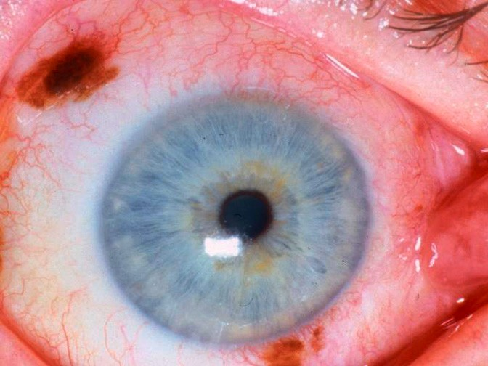

Slide 61
Pathology
“Atypical melanocytic proliferation present in a background of a conjunctival nevus most consistent with malignant melanoma, in situ and invasive”
0.28 mm depth of invasion
Prominent lymphoplasmacytic infiltrate

Slide 62
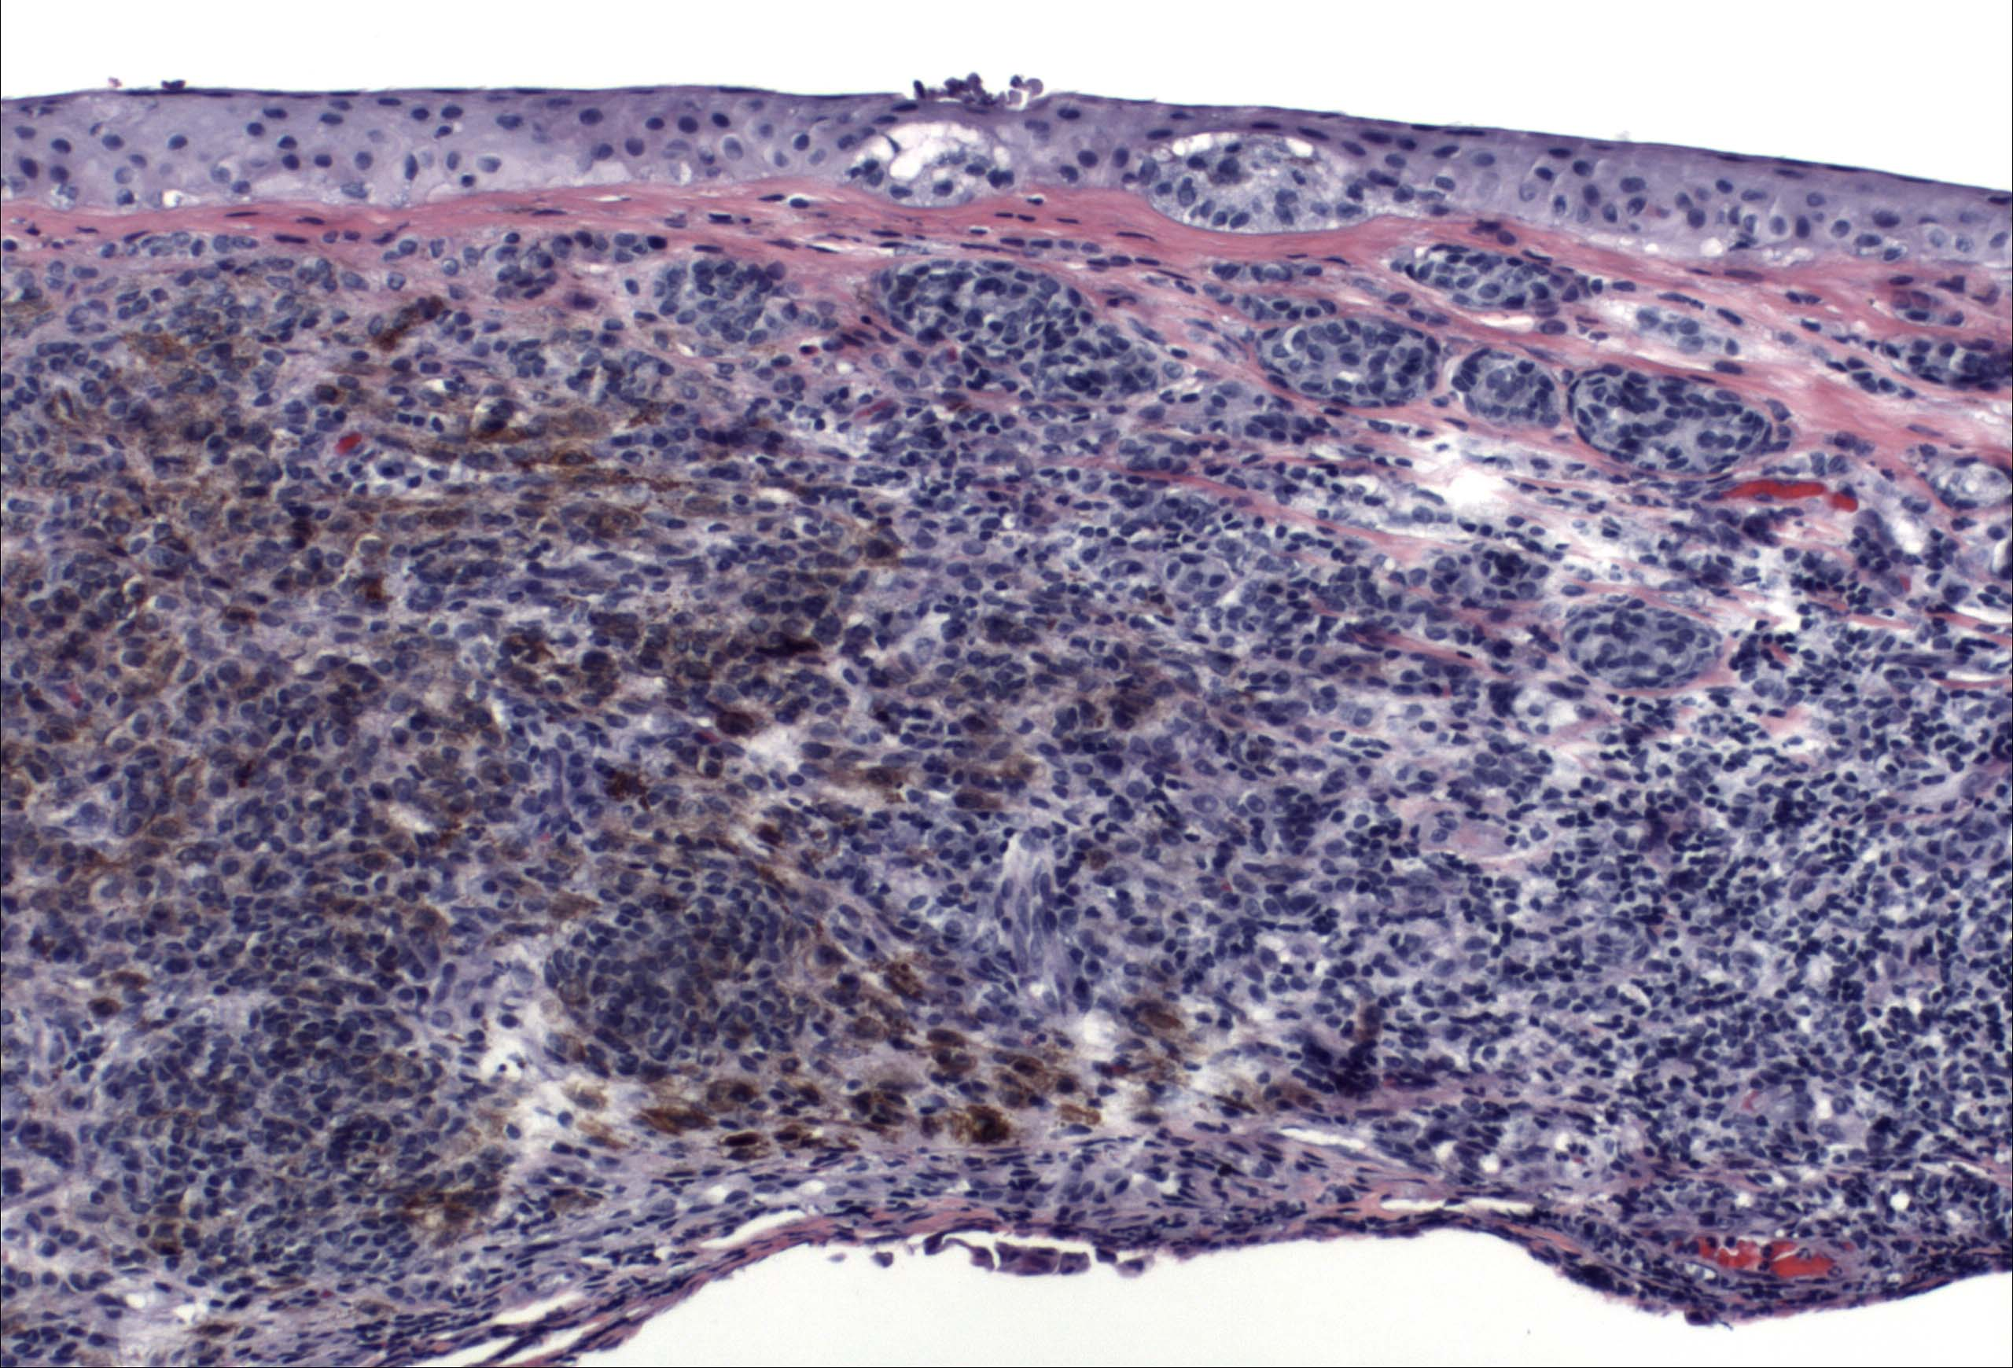
Pathology

Slide 63
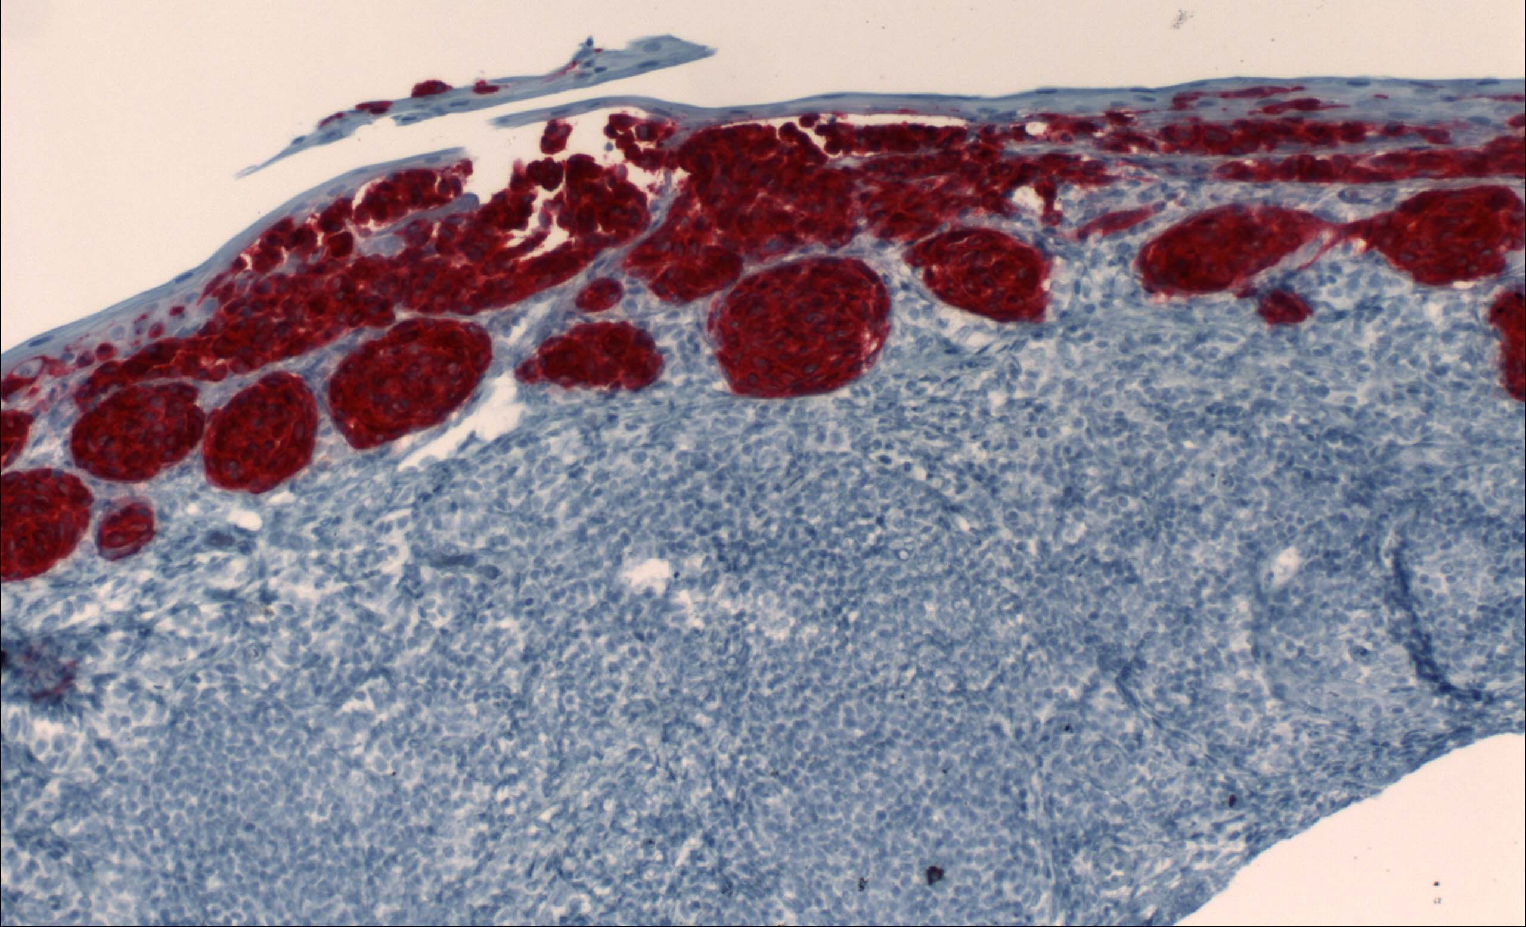
Pathology
Notes:
MART-1 Immunostain for Malignant Melanoma Frozen Sections

Slide 64
Malignant melanoma
1/40 as common as choroidal melanoma and 500 times less common than cutaneous melanoma
Affects 0.2 to 0.8 / million Caucasians
Incidence may be rising as cutaneous melanoma rates increase

Slide 65
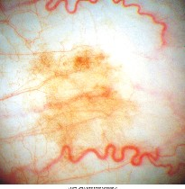
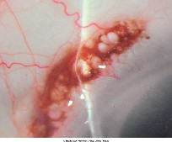
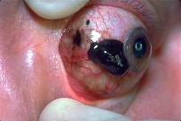
Origin of Melanoma
PAM: 50-75%
Nevus: 25%
De Novo: 15%

Slide 66
Pigmented Conjunctival Lesions
Racial melanosis: Bilateral patchy conjunctival pigmentation in dark skinned pts. Flat and patchy. Very rare conversion to melanoma.
Ocular melanocytosis: often associated with skin pigmentation (nevus of Ota). Slate gray scleral pigment. Can lead to choroidal melanoma.

Slide 67
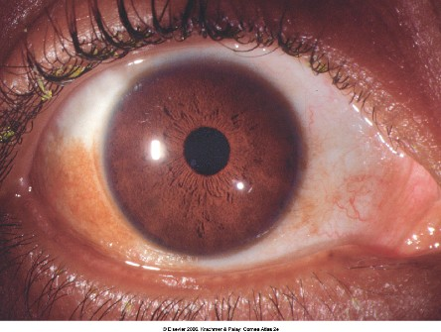
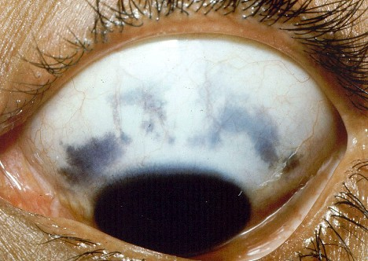

Slide 68
Pigmented Conjunctival Lesions
Primary acquired melanosis:
Unilateral, flat or patchy lesions usually in middle aged, fair-skinned pts (in 36% of Caucasians).
PAM with atypia leads to melanoma in 50% of pts -- should be excised with cryotherapy and followed every 2-3 mos initially.
Should be map-biopsied
PAM without atypia: follow every 6-12 mos with photographs

Slide 69
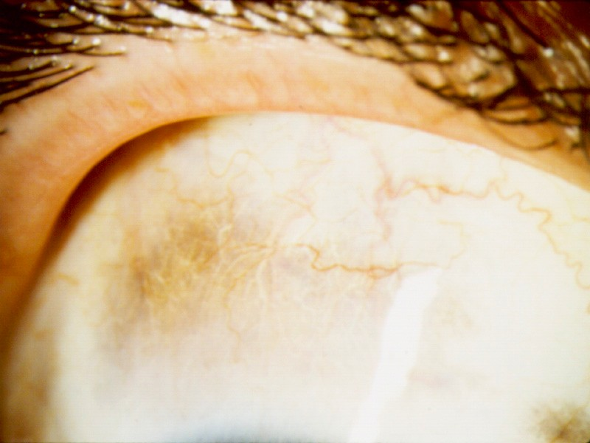

Slide 70
Pigmented Conjunctival Lesions
Conjunctival nevus:
Usually presents in the first two decades of life as pigmented well-circumscribed, elevated lesion.
Usually contains cysts.
Can be pigmented or non pigmented.
Pigment may increase at puberty or pregnancy
Fewer than 1% progression to melanoma
Follow with photos every 6-12 months

Slide 71
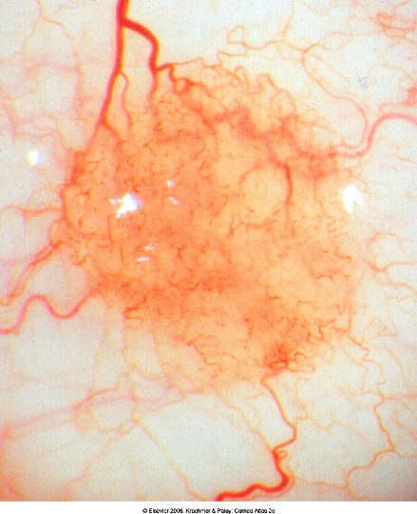

Slide 72
Malignant Melanoma
Clinical indications:
Change in
Color
Size
Shape
Irregular margins and surfaces

Slide 73
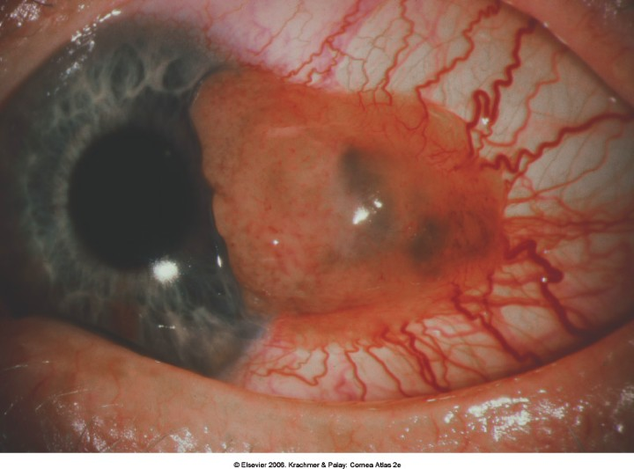
Notes:
Large limbal conj./corneal Melanoma.

Slide 74
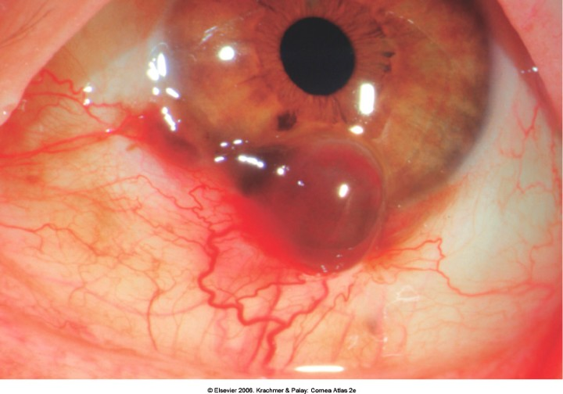
Notes:
Melanoma with hemorrhagic component

Slide 75
Malignant melanoma
Pathology
Abnormal melanocytes invade the substantia propria from the epithelium
Variable cell morphology: large pleomorphic cells, epithelioid, and spindle cells
Mitotic figures may be seen
Stains: HMB-45, S-100, and MELAN-A

Slide 76
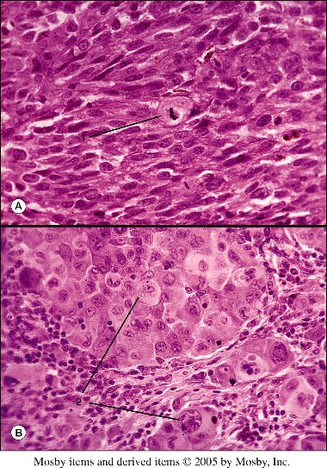
Notes:
Fig. 46.13 Malignant melanoma. Top, Composed of spindle type cells with mitotic activity (1) (AFIP Access. 790958, ×305). Bottom, Composed of epithelioid type cells (2) (AFIP Neg. 57-6310, ×365).

Slide 77
Malignant melanoma
Poor Prognosis:
High mitotic activity
Clusters of atypical cells
Large numbers of immature cells
Pagetoid or in situ pattern of invasion
Depth of invasion
>0.8 to 1.8 mm - more likely lethal (Silvers et al.)
Location
Non-bulbar conjunctiva
Invasion of sclera or orbit
Extension to skin margins

Slide 78
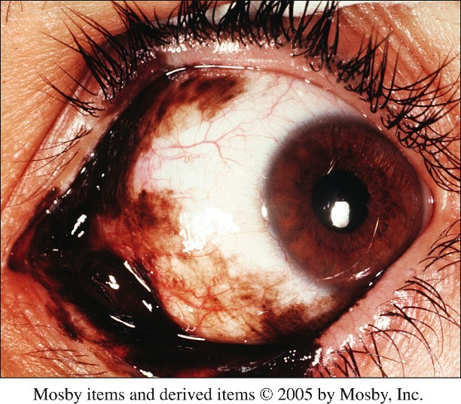

Slide 79
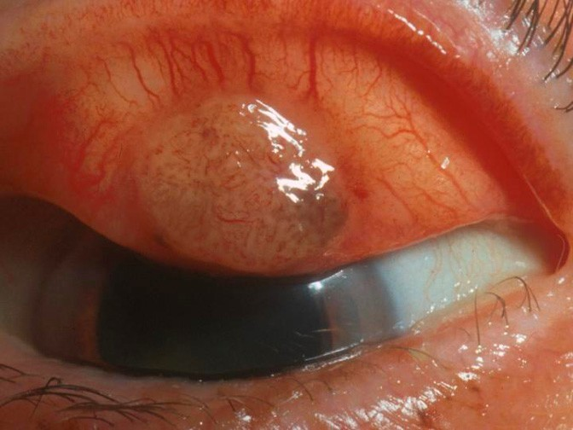

Slide 80
Malignant Melanoma
Prognosis
5 year survival: 84%
10 year survival: 71%
5 year recurrence: 39%

Slide 81
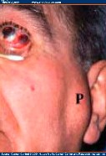
Malignant Melanoma
Metastasis:
Lymphatic invasion to regional lymph nodes
Preauricular and intraparotid nodes affected more frequently than submandibular and cervical LN’s
Invasion of lacrimal drainage systems
Systemic spread:
Lung, liver, brain, bone, skin, GI tract
Notes:
(to distinguish from hematogenous spread of choroidal melanomas)

Slide 82
Malignant melanoma
Management:
Complete excision with 3-4 mm margins
Cyotherapy in double freeze-slow-thaw technique
“No touch” technique, using each instrument only once
If cornea involved, use of beaver blade recommended to outline 2 mm margin followed by absolute alcohol swab and epithelial/limbal scraping
If sclera involved, lamellar sclerectomy with 1-2 mm margin ± cryotherapy
MMC QID for 2-4 one week cycles may be employed
Irradiation for recurrent cases or exenteration for advanced cases

Slide 83
Conclusions
Relatively rare tumor of the conjunctiva
Lymphatic spread and high mortality rate
Excise suspicious pigmented conjunctival lesions with cryotherapy

Slide 84
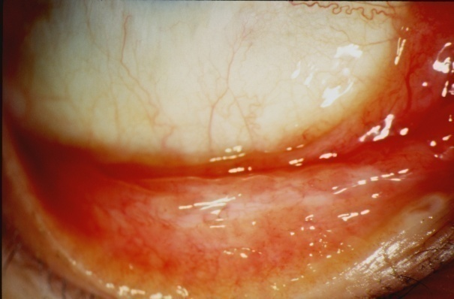
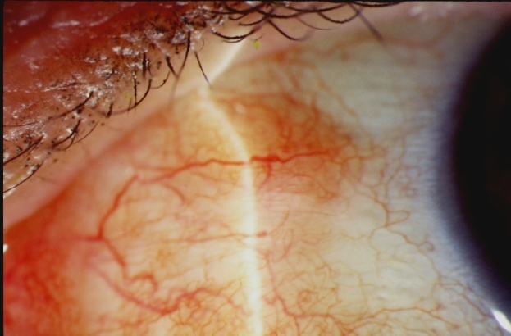
Case Presentation
51 year old female with history of follicular conjunctivitis for several years, also developed reddish bulbar conjunctival lesions
Benign lymphoid hyperplasia of conjunctiva diagnosed with biopsy and treated with radiation OD 10 years prior
While radiation improved follicular response OD, she remained steroid dependent due to bulbar conjunctival involvement
Developed cataracts and elevated IOP OU due to chronic steroid use; on timolol

Slide 85
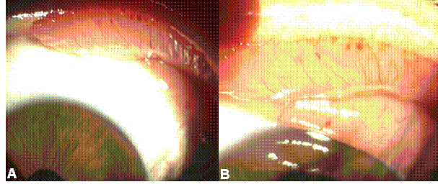
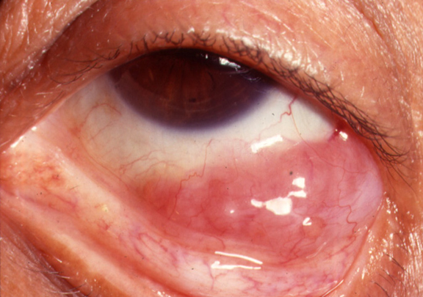
Conjunctival Lymphoid Tumors
Salmon colored-may be extension of intraocular or orbital disease
Clinical spectrum from benign lymphoid hyperplasia to lymphoma
Non-Hodgkins B cell most common
Orbital and adnexal lymphoma associated with systemic lymphoma in 30-35%
Treated with radiation or excision and cryotherapy (chemotherapy for aggressive or systemic disease)

Slide 86
Conclusions
Tumors of the conjunctiva and cornea, while relatively uncommon, are treatable when diagnosed early
Appropriate diagnosis is made with incisional or excisional biopsy
Treatment of the tumor depends on the diagnosis and typically involves surgical removal, adjunctive chemotherapy or radiation, and close observation

